Slide 1
Artificial Neural Network : Introduction
Soft Computing Applications
23.03.2018
1 / 20

Slide 2
Introduction
Neural networks are artificial systems that were inspired by biological neural networks. These systems learn to perform tasks by being exposed to various datasets and examples without any task-specific rules.
The idea is that the system generates identifying characteristics from the data they have been passed without being programmed with a pre-programmed understanding of these datasets.
Neural networks are based on computational models for threshold logic. Threshold logic is a combination of algorithms and mathematics.
Neural networks are based either on the study of the brain or on the application of neural networks to artificial intelligence. The work has led to improvements in finite automata theory.

Slide 3
Supervised vs Unsupervised Learning:
Neural networks learn via supervised learning; Supervised machine learning involves an input variable x and output variable y. The algorithm learns from a training dataset. With each correct answers, algorithms iteratively make predictions on the data. The learning stops when the algorithm reaches an acceptable level of performance.
Unsupervised machine learning has input data X and no corresponding output variables. The goal is to model the underlying structure of the data for understanding more about the data. The keywords for supervised machine learning are classification and regression. For unsupervised machine learning, the keywords are clustering and association.

Slide 4
Biological nervous system
Biological nervous system is the most important part of many living things, in particular, human beings.
There is a part called brain at the center of human nervous system.
In fact, any biological nervous system consists of a large number of interconnected processing units called neurons.
Each neuron is approximately 10µm long and they can operate in parallel.
Typically, a human brain consists of approximately 10¹¹ neurons communicating with each other with the help of electrical impulses.
Soft Computing Applications
23.03.2018
4 / 20

Slide 5
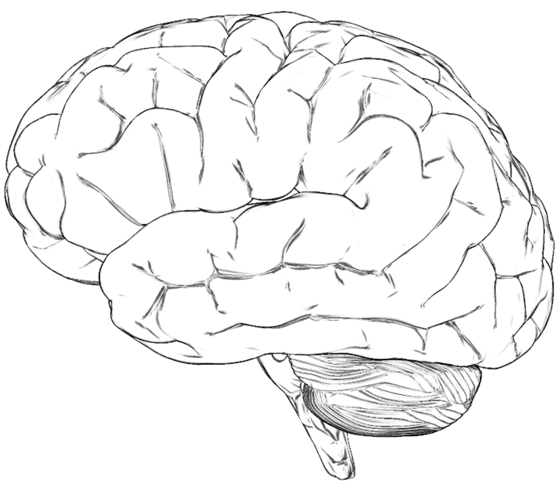
Brain: Center of the nervous system
Soft Computing Applications
23.03.2018
5 / 20

Slide 6
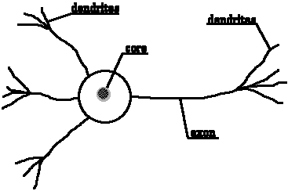
Dendrite of another neuron
Neuron: Basic unit of nervous system
Synapse
soma
Soft Computing Applications
23.03.2018
6 / 20

Slide 7
Neuron and its working
Dendrite of another neuron
Synapse
soma
Figure shows a schematic of a biological neuron. There are different parts in it : dendrite, soma, axon and synapse.
Dendrite : A bush of very thin fibre.
Axon : A long cylindrical fibre.
Soma : It is also called a cell body, and just like as a nucleus of cell.
Synapse : It is a junction where axon makes contact with the dendrites of neighboring dendrites.
Soft Computing Applications
23.03.2018
7 / 20

Slide 8
Neuron and its working
There is a chemical in each neuron called neurotransmitter.
A signal (also called sense) is transmitted across neurons by this chemical.
That is, all inputs from other neuron arrive to a neurons through dendrites.
These signals are accumulated at the synapse of the neuron and then serve as the output to be transmitted through the neuron.
An action may produce an electrical impulse, which usually lasts for about a millisecond.
Note that this pulse generated due to an incoming signal and all signal may not produce pulses in axon unless it crosses a threshold value.
Also, note that an action signal in axon of a neuron is commutative signals arrive at dendrites which summed up at soma.
Soft Computing Applications

Slide 9
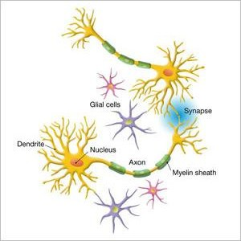
Neuron and its working
Soft Computing Applications

Slide 10
Artificial neural network
In fact, the human brain is a highly complex structure viewed as a massive, highly interconnected network of simple processing elements called neurons.
Artificial neural networks (ANNs) or simply we refer it as neural network (NNs), which are simplified models (i.e. imitations) of the biological nervous system, and obviously, therefore, have been motivated by the kind of computing performed by the human brain.
The behavior of a biolgical neural network can be captured by a simple model calledartificial neural network.
Soft Computing Applications

Slide 11
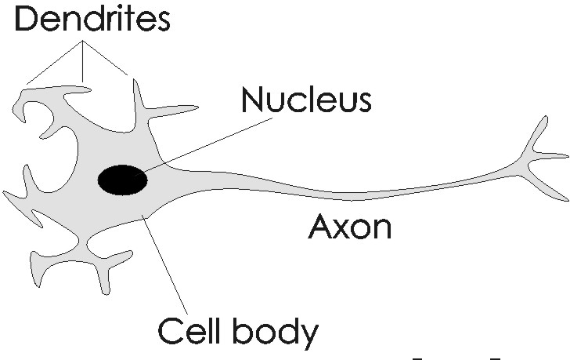


Analogy between BNN and ANN
x1
w1
x2
w2
w3
x3
wn
xn
Soft Computing Applications

Slide 12
Artificial neural network
We may note that a neutron is a part of an interconnected network of nervous system and serves the following.
Compute input signals
Transportation of signals (at a very high speed) Storage of information
Perception, automatic training and learning
We also can see the analogy between the biological neuron and artificial neuron. Truly, every component of the model (i.e. artificial neuron) bears a direct analogy to that of a biological neuron. It is this model which forms the basis of neural network (i.e. artificial neural network).
Soft Computing Applications

Slide 13

Artificial neural network
x1
w1
x2
w2
w3
x3
wn
xn
…..
input
weight
Summation unit
Threshold unit
output
Here, x₁, x₂, · · · , x_{n} are the n inputs to the artificial neuron.
w₁, w₂, · · · , w_{n} are weights attached to the input links.
Soft Computing Applications

Slide 14
Artificial neural network
Note that, a biological neuron receives all inputs through the dendrites, sums them and produces an output if the sum is greater than a threshold value.
The input signals are passed on to the cell body through the synapse, which may accelerate or retard an arriving signal.
It is this acceleration or retardation of the input signals that is modeled by the weights.
An effective synapse, which transmits a stronger signal will have a correspondingly larger weights while a weak synapse will have smaller weights.
Thus, weights here are multiplicative factors of the inputs to account for the strength of the synapse.
Soft Computing Applications

Slide 15
Artificial neural network
Hence, the total input say I received by the soma of the artificial neuron is
Σ
I = w₁x₁ + w₂x₂ + · · · + w_{n}x_{n} =
n i =1
w_{i} x_{i}
To generate the final output y , the sum is passed to a filter φ
calledtransfer function, which releases the output.
That is, y = φ(I)
Ø(I)
x1
w1
x2
w2
I
y
w3
x3
wn
…..
xn
Summation unit
input
weight
Threshold unit
output
Soft Computing Applications

Slide 16
Artificial neural network
A very commonly known transfer function is the thresholding function.
In this thresholding function, sum (i.e. I) is compared with a threshold value θ.
If the value of I is greater than θ, then the output is 1 else it is 0 (this is just like a simple linear filter).
In other words,
Σ
y = φ(
n i =1
w_{i} x_{i} − θ)
1 , if I > θ
0 , if I ≤ θ
where
.
φ(I) =
Such a Φ is calledstep function(also known asHeaviside function).
Soft Computing Applications

Slide 17




Artificial neural network
Following figures illustrates two simple thresholding functions.
output
+1.0
(I)
(I)
0
input
-1.0
I
(a) Hard-limit transfer function
(b) Signum transfer function
Soft Computing Applications

Slide 18
Transformation functions
Hard-limit transfer function : The transformation we have just discussed is called hard-limit transfer function. It is generally used in perception neuron.
In other words,
.
1 , if I > θ
0 , if I ≤ θ
φ(I) =
Linear transfer function : The output of the transfer function is made equal to its input (normalized) and its lies in the range of
−1.0 to +1.0. It is also known as Signum or Quantizer function
and it defined as
.
+1 , if I > θ
−1 , if I ≤ θ
φ(I) =
Soft Computing Applications

Slide 19
Other transformation functions
Sigmoid transfer function : This function is a continuous function that varies gradually between the asymptotic values 0 and 1 (called log-sigmoid) or -1 and +1 (called Tan-sigmoid) threshold function and is given by
φ(I) = ¹ [log-Sigmoid]
_{1+e}−αI
φ(I) = tanh(I) = ^{eαI −e−αI} [tan-Sigmoid]
_{e}αI _{+e}−αI
Here, α is the coefficient of transfer function.
Soft Computing Applications

Slide 20




Transfer functions in ANN
1
α=10
(I)
α=1.0
α=0.3
1
α=10
α=0.5
(I)
α=1.0
α=0.3
-1
1
-1
α=0.5
1
0
0
-1
-1
(a) Log-Sigmoid transfer function
(b) Tan-Sigmoid transfer function
Soft Computing Applications

Slide 21
Advantages of ANN
ANNs exhibits mapping capabilities, that is, they can map input patterns to their associated output pattern.
The ANNs learn by examples. Thus, an ANN architecture can be trained with known example of a problem before they are tested for their inference capabilities on unknown instance of the problem. In other words, they can identify new objects previous untrained.
The ANNs posses the capability to generalize. This is the power to apply in application where exact mathematical model to problem are not possible.
Soft Computing Applications

Slide 22
Advantages of ANN
The ANNs are robust system and fault tolerant. They can therefore, recall full patterns from incomplete, partial or noisy patterns.
The ANNS can process information in parallel, at high speed and in a distributed manner. Thus a massively parallel distributed processing system made up of highly interconnected (artificial) neural computing elements having ability to learn and acquire knowledge is possible.
Soft Computing Applications

Slide 23
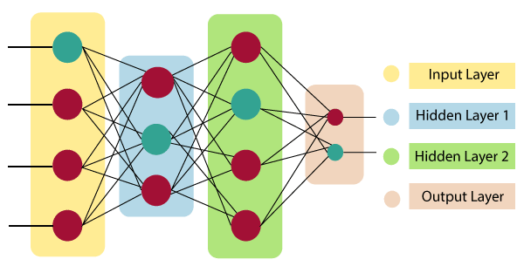
The architecture of an artificial neural network:

Slide 24
Input Layer:
As the name suggests, it accepts inputs in several different formats provided by the programmer.
Hidden Layer:
The hidden layer presents in-between input and output layers. It performs all the calculations to find hidden features and patterns.
Output Layer:
The input goes through a series of transformations using the hidden layer, which finally results in output that is conveyed using this layer.
The artificial neural network takes input and computes the weighted sum of the inputs and includes a bias. This computation is represented in the form of a transfer function.

Slide 25

It determines weighted total is passed as an input to an activation function to produce the output. Activation functions choose whether a node should fire or not. Only those who are fired make it to the output layer. There are distinctive activation functions available that can be applied upon the sort of task we are performing.

Slide 26
How do artificial neural networks work?
Artificial Neural Network can be best represented as a weighted directed graph, where the artificial neurons form the nodes. The association between the neurons outputs and neuron inputs can be viewed as the directed edges with weights. The Artificial Neural Network receives the input signal from the external source in the form of a pattern and image in the form of a vector. These inputs are then mathematically assigned by the notations x(n) for every n number of inputs.

Slide 27
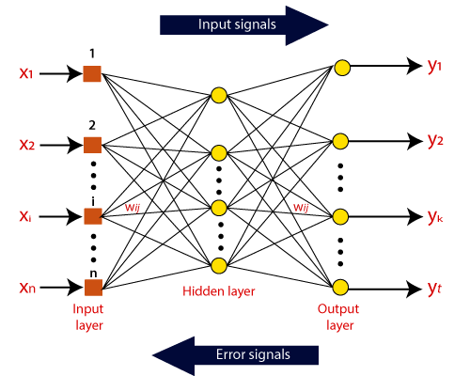

Slide 28
Afterward, each of the input is multiplied by its corresponding weights ( these weights are the details utilized by the artificial neural networks to solve a specific problem ). In general terms, these weights normally represent the strength of the interconnection between neurons inside the artificial neural network. All the weighted inputs are summarized inside the computing unit.
If the weighted sum is equal to zero, then bias is added to make the output non-zero or something else to scale up to the system's response. Bias has the same input, and weight equals to 1. Here the total of weighted inputs can be in the range of 0 to positive infinity. Here, to keep the response in the limits of the desired value, a certain maximum value is benchmarked, and the total of weighted inputs is passed through the activation function.

Slide 29
The activation function refers to the set of transfer functions used to achieve the desired output. There is a different kind of the activation function, but primarily either linear or non-linear sets of functions. Some of the commonly used sets of activation functions are the Binary, linear, and Tan hyperbolic sigmoidal activation functions. Let us take a look at each of them in details:
Binary:
In binary activation function, the output is either a 1 or a 0. Here, to accomplish this, there is a threshold value set up. If the net weighted input of neurons is more than 1, then the final output of the activation function is returned as 1 or else the output is returned as 0.

Slide 30
Sigmoidal Hyperbolic:
The Sigmoidal Hyperbola function is generally seen as an "S" shaped curve. Here the tan hyperbolic function is used to approximate output from the actual net input. The function is defined as:
F(x) = (1/1 + exp(-????x))
Where ???? is considered the Steepness parameter.

Slide 31
Types of Artificial Neural Networks

Slide 32
FeedBack Neural Network
The feedforward neural network is one of the most basic artificial neural networks. In this ANN, the data or the input provided travels in a single direction. It enters into the ANN through the input layer and exits through the output layer while hidden layers may or may not exist. So the feedforward neural network has a front propagated wave only and usually does not have backpropagation. .

Slide 33
Feedforward Neural Network
The feedforward neural network is one of the most basic artificial neural networks. In this ANN, the data or the input provided travels in a single direction. It enters into the ANN through the input layer and exits through the output layer while hidden layers may or may not exist. So the feedforward neural network has a front propagated wave only and usually does not have backpropagation. .

Slide 34
Recurrent Neural Network
The Recurrent Neural Network saves the output of a layer and feeds this output back to the input to better predict the outcome of the layer. The first layer in the RNN is quite similar to the feed-forward neural network and the recurrent neural network starts once the output of the first layer is computed. After this layer, each unit will remember some information from the previous step so that it can act as a memory cell in performing computations.

Slide 35
Convolutional Neural Network
A Convolutional neural network has some similarities to the feed-forward neural network, where the connections between units have weights that determine the influence of one unit on another unit. But a CNN has one or more than one convolutional layers that use a convolution operation on the input and then pass the result obtained in the form of output to the next layer. CNN has applications in speech and image processing which is particularly useful in computer vision.

Slide 36
Modular Neural Network
A Modular Neural Network contains a collection of different neural networks that work independently towards obtaining the output with no interaction between them. Each of the different neural networks performs a different sub-task by obtaining unique inputs compared to other networks. The advantage of this modular neural network is that it breaks down a large and complex computational process into smaller components, thus decreasing its complexity while still obtaining the required output.

Slide 37
Radial basis function Neural Network
Radial basis functions are those functions that consider the distance of a point concerning the center. RBF functions have two layers. In the first layer, the input is mapped into all the Radial basis functions in the hidden layer and then the output layer computes the output in the next step. Radial basis function nets are normally used to model the data that represents any underlying trend or function.

Slide 38
Applications of Artificial Neural Networks
Social Media
Marketing & sales
Healthcare
Personal Assistants in NLP

